Slide 1

KNN: your first Machine Learning Algo

Slide 2

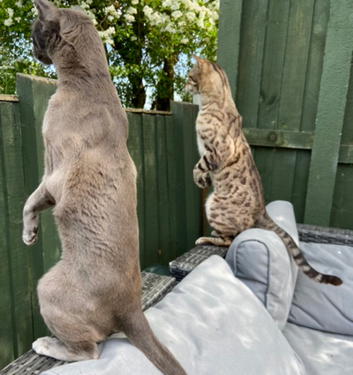
TODAY: WE WILL LEARN ABOUT OUR FIRST ALGORITHM
K- Nearest Neighbours (KNN)
Can be used for both classification or regression
Supervised ML Algorithm
Assumes that similar things are "closer* together"
*Question for next classes: what does closer mean?
Data Squad | Intro to AI

Slide 3
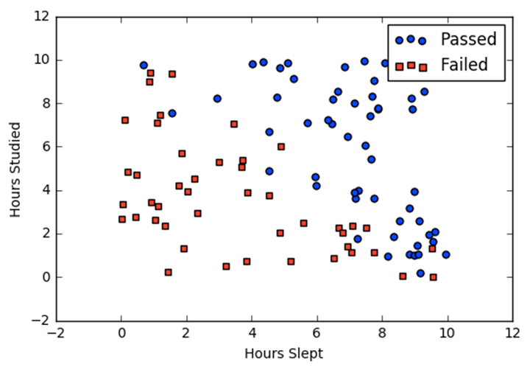
KNN: THE ALGORITHM
Imagine you have two independent variables: Hours Slept and Hours studied
These are known as our features
or inputs.
We are trying to predict if a person with certain hours studied and hours slept before a test will pass or fail.
The category pass or fail is an example of the target variable we are trying to predict in supervised ML
Data Squad | Intro to AI

Slide 4
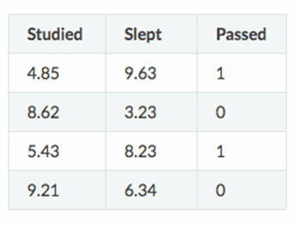

KNN: THE ALGORITHM
The process involved mapping the points available to the feature space
Very Simple Training Process -> there are no model parameters to optimise only hyperparameter K (number of neighbours)
Data Squad | Intro to AI

Slide 5

KNN: THE ALGORITHM
The process involved mapping the points available to the feature space
K = 3
Insert a new point from the test data set
Evaluate the 3 closest neighbours
Data Squad | Intro to AI

Slide 6

KNN: THE ALGORITHM
The process involved mapping the points available to the feature space
K = 3
Insert a new point from the test data set
Evaluate the 3 closest neighbours
Data Squad | Intro to AI

Slide 7
KNN: THE ALGORITHM
The process involved mapping the points available to the feature space
Apply a majority vote system
And assign the class of the winner.
Data Squad | Intro to AI

Slide 8
KNN: THE ALGORITHM
What if it were regression?
Evaluate the neighbours and perform an anverage of the target variable's results
Data Squad | Intro to AI

Slide 9
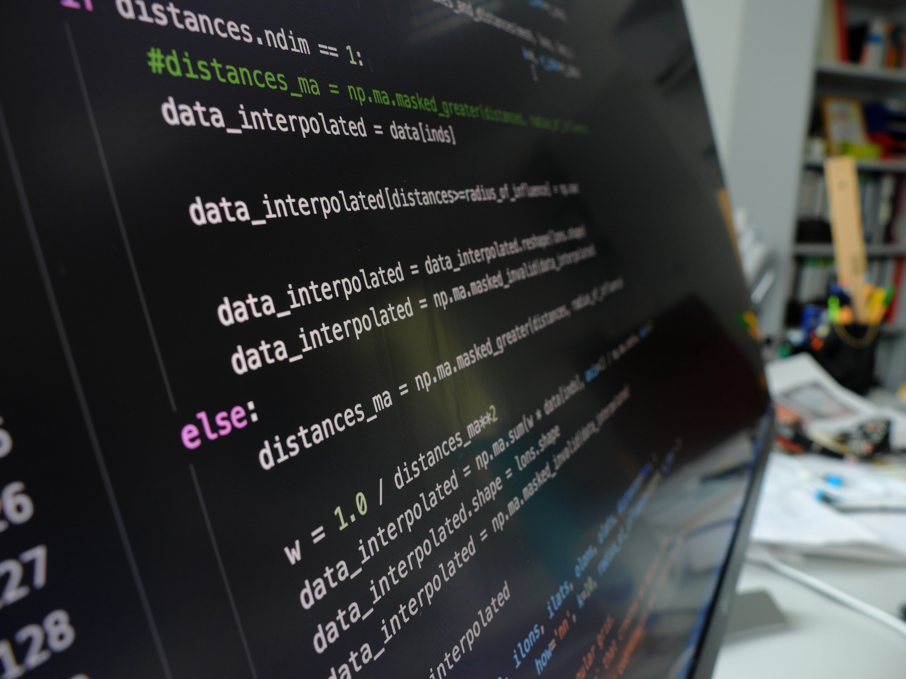
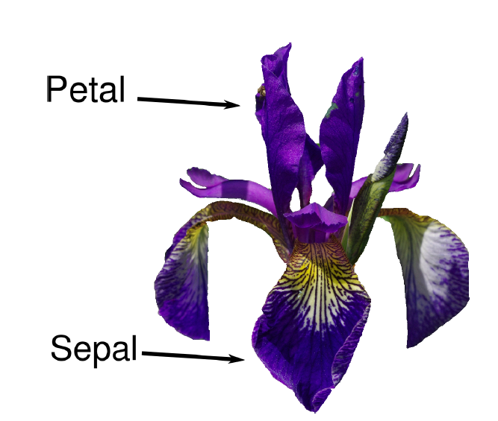
PYTHON CODE TIME
Iris Dataset
Data Squad | Statistics Introdution

Slide 10
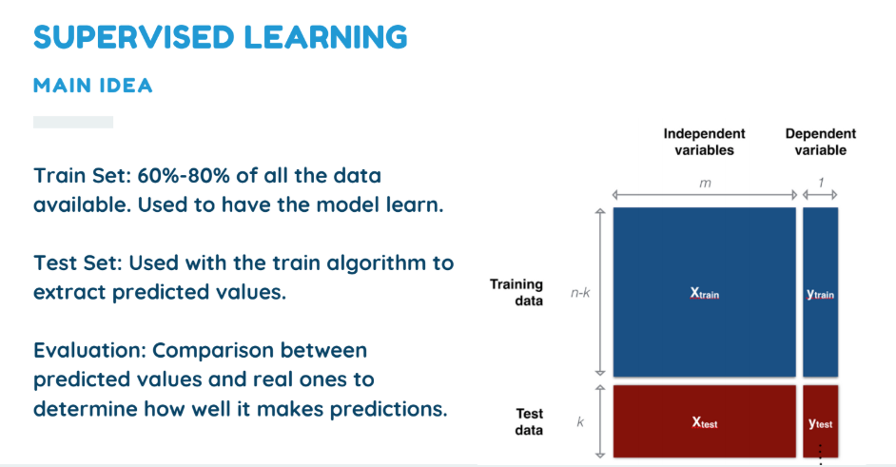
SUPERVISED LEARNING
MAIN IDEA (we will cover this in depth on another day)
Train Set: 60%-80% of all the data available. Used to have the model learn.
Test Set: Used with the train algorithm to extract predicted values.
Evaluation: Comparison between predicted values and real ones to determine how well it makes predictions.
Data Squad | Intro to AI

Slide 11
EXAMPLES
(Lets see it in Python)

Slide 12
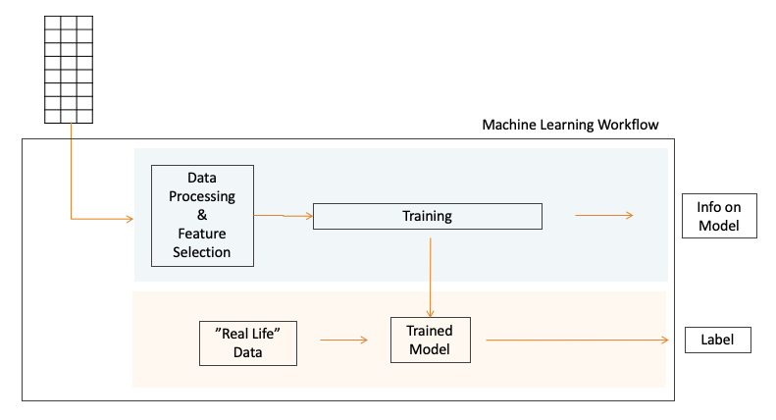
PYTHON CODE TIME
Iris Dataset
Data Squad | Intro to AI

Slide 13





ANY QUESTIONS ?

Slide 14
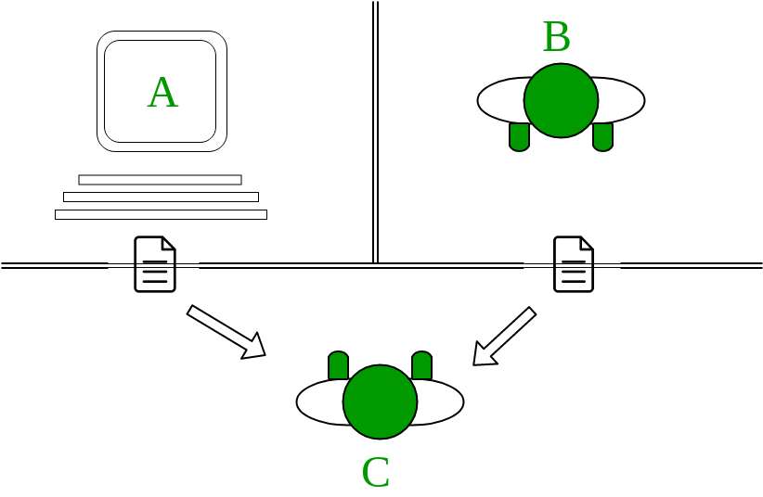
TURING TEST
Data Squad | Intro to AI

Slide 15
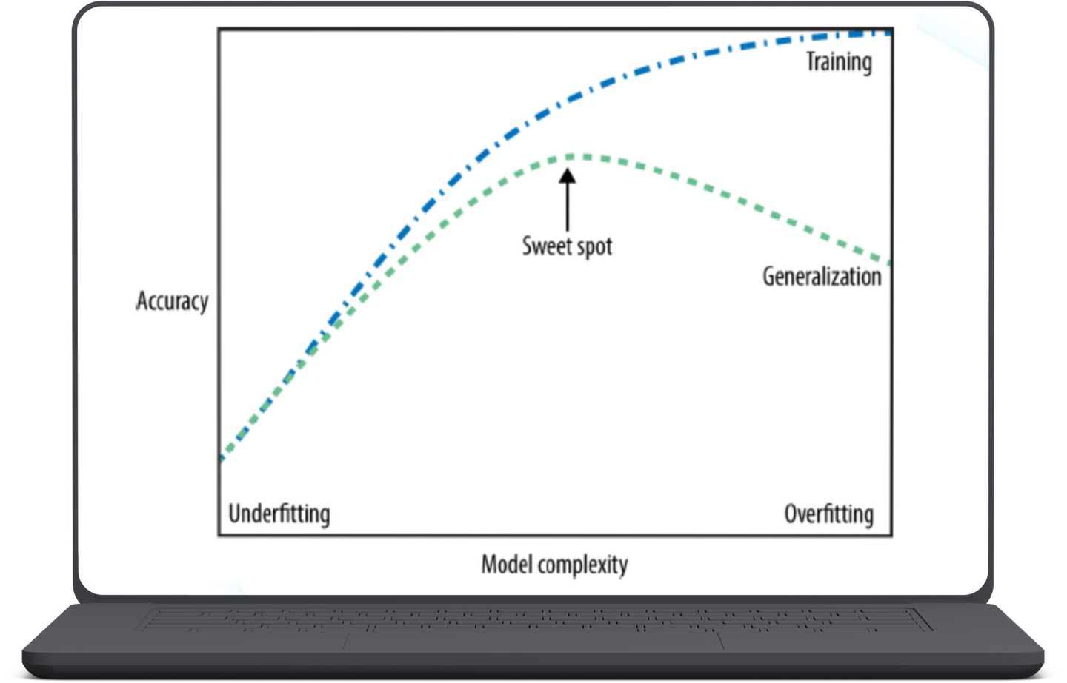
GENERALIZATION, UNDERFITTING & OVERFITTING
Data Squad | Intro to AI

